Slide 1
WBUQ
Get lost in the stream.
Dr. Ganahl
PR Theory and Practice
Spring 2014
BAD DOG:
Lindsay Cochario, Sam Forvour, Nicole Keiser, Sean Potor, and Melissa Trabbold.
BAD DOG

Slide 2
Table of Contents
Executive Summary…………………………………………………………………………………….......………………………….3
Research:………………………………………………………………………………………………………………………………….4-15
Client Research…………………………………………………………………………………………………………4-6
Opportunity and Problems………………………………………………………..............…………………7-9
Audience and Public Research…………………………………………………………………………….10-12
Research Design……………………………………………………………………………………………….….……13
Objectives:………………………………………………………………………………………………………………………..……14-16
Programming and PR Tactics:…………………………………………………………………………………………………17-26
Written……………………………………………………………………………………………………………………..18
Visual………………………………………………………………………………………………………….…………….19
Electronic………………………………………………………………………………………………………..…………21
Special Events………………………………………………………………………………………………..………….22
Spoken………………………………………………………………………………………………..…………………….23
Media Relations……………………………………………………………………………………………………………….………….24
Big Idea……………………………………………………………………………………………………………………………………....25
Flow Chart…………………………………………………………………………………………………………………………………..27
Suggestions…………………………………………………………………………………………………………………………………28
Evaluation……………………………………………………………………………………………………………………………..29-30

Slide 3
Executive Summary
The mission of our campaign is to effectively communicate a message and promise for WBUQ to its target audience. We want to build the awareness of this radio station, and create an affective brand that will keep listeners connected and coming back for more.
The following slides briefly summarize our team’s strategic plan in creating a promising brand for WBUQ that will increase listenership and student involvement.
Bad Dog is dedicated to helping our client reach its fullest potential through proactive planning, enhanced programming, and promotional tactics.

Slide 4
Client Research: Mission & Scope
“WBUQ is a 600 watt non-commercial, educational radio station operating at FM 91.1 MHz. WBUQ is a student-run radio station, and provides a means of student training and experience in radio broadcasting, to provide a means of entertainment and information for the student body and community, to serve the public interest, and to be an instrument of expression for student, faculty and community opinion, in accordance with the rules of the FCC” -WBUQ
The radio station is considered a nonprofit organization and another student club on campus.
Client Research

Slide 5
Client Research: History
WBUQ started in the 1980’s. Their format at the time was playing only Heavy metal, Alternative rock, and punk.
Now its format consists of more variety, and more of what today’s typical college students want to listen to.
Fall of 2013 was their first year they offered internet streaming.
Client Research

Slide 6
Client Research: Competition
94.7 WHLM and streaming services such as Pandora and Spotify are considered a threat to WBUQ.
Many students do not own stereos, since they have stopped making them due to wireless technology. That’s why many students turn to streaming services. Its easy and portable.
iTunes, Pandora, and Sirius.

Slide 7
Opportunity and Problems: Situational
WBUQ’s lack of advertising is one of the factors why the station is not promoted properly. Advertising at home sporting events, throwing concerts on ‘hot spots’ on campus, and throwing fundraisers will potentially raise some revenue for its radio station; so it won’t have to rely on student dues for sources of money flow.
The station’s Twitter account actively has 48 followers, and only 43 likes on its Facebook page. If WBUQ was on other social media sites such as Tumblr, Vine or Instagram, the station could possibly attract more listeners and followers.
The station only streams on the Internet. They don’t have any apps that students can listen to on mobile devices.
The station should have places like the Student Recreational Center, University Store, and local businesses play their station during normal business hours.
Opportunity & Problem

Slide 8
Opportunity and Problems: Proactive/Reactive
Proactive: Students want to see more giveaways and promotions from the station—more interactions. They would even like to see set programming for listeners. WBUQ needs to have a set schedule for shows.
Reactive: The station must integrate new sources of technology, such as mobile apps and podcasts. They could record the shows to put on YouTube just like they would for some of the ESPN radio programs. They should also look into iheart radio for smartphone streaming.
Opportunity & Problem

Slide 9
Opportunity and Problems: PR Type
WBUQ is considered a nonprofit organization. In order to air advertisements for local businesses, the station would have to apply for a different license.
It is a student run radio station.
The station is considered an in-house controlled media outlet. This is because it is a part of the university.
Could use more media relations for further publicity.
Opportunity & Problem

Slide 10
Audience & Public Research: Demographics/Psychological
Demographic: The genre of the music is more of today’s music that college students listen to, but there is a wide variety. The station reaches a diverse group of students. The average age it appeals to is 18-22. It mainly plays music that is youthful, rather than older dated music.
Psychological: The music is more driven to put the listener in a better state of mind. The different genres of music allow for many types of students to get lost in the goodness. If a listener is engaged in their personal taste of music, they are more likely to feel a rush of energy, and overall improved mood.
Audience & Public Research

Slide 11
Audience & Public Research: Behavior
The niche audience is Bloomsburg University college students. The music is catered toward their liking of genres such as rock, top 40, and hip hop.
Secondary audience includes faculty/staff at the university, and locals
The locals tend to tune into WHLM for classic rock and oldies because most of the locals grew up in that era of music. The station also offers local and national news. They are a part of the CBS news network.
Audience & Public Research

Slide 12
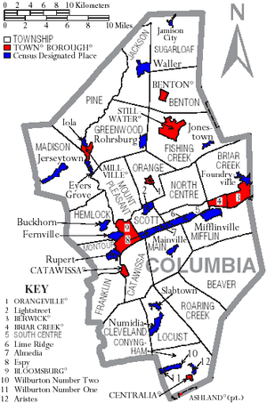
Audience & Public Research: Size
The broadcast signal reaches within a 25-30 mile radius from Bloomsburg University.
Over 9,950 students at Bloomsburg University. (Both Undergraduate and graduate).
The town of Bloomsburg has an approximate population of 15,000.
Audience & Public Research

Slide 13
Research Design: Secondary/Primary Research
Secondary:
In depth studies of radio stations:
WBUQ
Sirius
Pandora
Temple University Radio
Seton Hall
Powerhouse 96.5
KISS FM
40 % of Americans are listening to audio on digital devices. (Via:stateofthemedia.org/2012/audio-how-far-will-digital-go/audio-by-the-numbers/)
Primary:
Intensive Interview (which we conducted)
Survey, Focus Groups, Field Observation, Content Analysis, etc.
Need for upgrades into mobile apps for smart phones and tablet integration.
Genre-free station creates unique identity that satisfies a diverse group of students—their target audience.
Need to raised awareness.
Findings:
Sirius is a subscription based; Pandora is driven by advertising.
College radio stations such as Seton Hall and Temple focus on a specific genre: WBUQ cover multiple genres.
Benefits and disadvantages
Research Design

Slide 14
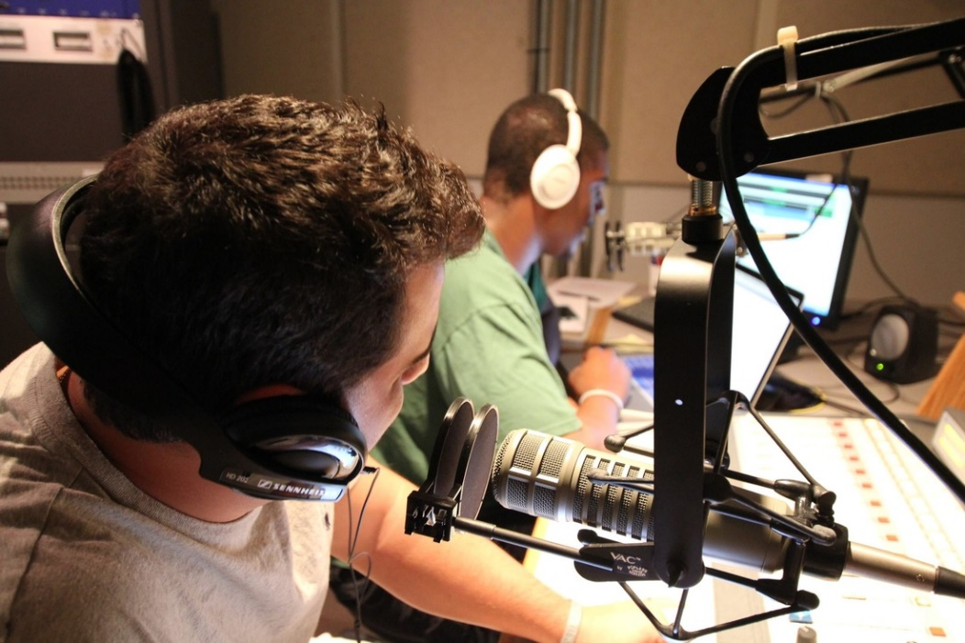
WBUQ’s Objective
This student run radio station gives students a place to voice their opinions using their talents, all while learning and preparing themselves for future radio broadcasting careers. Students gain experience and knowledge, while having fun!

Slide 15
Our Objective
Bad Dog seeks to raise awareness of WBUQ to Bloomsburg students. We want to enlarge the audience and expand the radio station. We’ll inform other students about what WBUQ does and gain people’s interest to tune in, and possibly become involved with starting their own show. We want to encourage others to get involved and help advertise the station with multiple publicity and PR tactics, and spread promotion outside of Bloomsburg University, as well.
“You are the revolution.”

Slide 16
Output Objectives
Controlled Media:
Frequent updates on social networking sites:
Facebook
Twitter
Website
Website
Flyers/posters around campus
Work with other on campus organizations to promote
Send emails out to students
Uncontrolled Media:
Press Releases and articles written in BUnow, The Press Enterprise, and The Voice
Promote on HuskyTV and BUnow’s YouTube channel

Slide 17
Programming/PR Tactics
Throughout the 12-month campaign, we incorporated multiple tactics to promote WBUQ and build awareness.
WBUQ lacked publicity, so we needed a strong variety of PR and advertising tactics to help gain listeners, and connect the station and its programming to a larger audience.
Written, visual, electronic, spoken, and special events

Slide 18
Written Tactics
News Release
Press Enterprise, The Voice
Contribute stories and articles to post to different student mass media organizations
BUnow, The Voice, Her Campus, Umag
Handouts
WBUQ Magazine

Slide 19
Visual Tactics
Flyers on and off campus
Promoting special events and spreading existence of its social media
Posters at music venues and other publicity events
Advertisements
On various websites, flyers, videos

Slide 21
Electronic Tactics
Engaging utilization of WBUQ’s social media accounts
This is a preferred channel of communication for WBUQ’s target audience
Website recommendations
Interactive videos posted to website, social media accounts, and other student organizations
Twitter
Facebook
Tumblr
Blog
Reviews and comments regarding the station’s music and programming
Emails to students

Slide 22
Special Events
Take full advantage of new PA system
Broadcast station at sports tailgate events like football games
Contests for opportunity to win prizes
“Open Mic” night with local artists and WBUQ’s DJs
Tents with free giveaways
Partner with local artist or those involved with BU’s concerts/music venues
Fundraisers to raise money for contests and events
Bake sale, money jars placed on and off campus
...all of these events are leading up to the MUSIC FEST we will hold on the quad in the upcoming Fall 2014

Slide 23
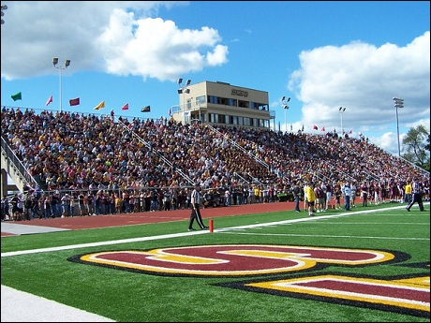
Spoken
Commentate BU’s sports games
Call-in’s for song requests and contests
WBUQ’s talk shows presented on the quad
Promote special events through loud speakers in on-campus buildings

Slide 24
Media Relations
Partnerships/marketing relationships
with multiple student organizations
BU’s open mic coordinators
Local music venues
Mass media organizations (BUnow, The Voice, etc.)
Student Rec Center
create stronger network connections to spread WBUQ’s awareness more effectively
Community relations
Local artist performances
Karaoke night

Slide 25
The Big Idea: WBUQ MUSIC FEST
“Get lost in the stream.”
Students will feel a great sense of connectedness to WBUQ and the student body through engaging events that will drive its publicity leading up to the ultimate event: The WBUQ Music Fest
The WBUQ Music Fest in the upcoming Fall 2014 will be the huge anticipated event where students will come together in the quad and share the goodness of WBUQ’s diverse selection of music. The station will be broadcasted through its new PA system with its DJ’s, as well as local artists. With a “rock party” theme, there will be blow up guitars supporting WBUQ, as well as sparklers.
Students will enjoy an all-day party filled with all kinds of music and people, and leave wanting more of WBUQ. We hope more students will recognize WBUQ and become involved with the organization.

Slide 26
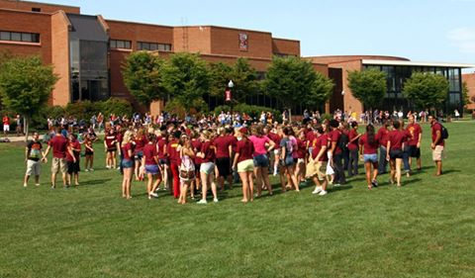

Slide 27
Flow Chart
Tactics | June | July | August | Sept. | Oct. | Nov. | Dec. | Jan. | Feb. | March | April | May
News Release
Articles
Flyers
Ads/Posters
Social Media
Electronic Interactivity
PA System
Sporting Event
Contests/ Giveaways
Open Mics
Fundraisers
Local Events
Music Fest
Semester Concerts

Slide 28
Suggestions
More interactive website
Comment page
Music review page
Additional social media accounts
Instagram
More DJ’s to fill schedule
Invest in iHeartRadio
To integrate into smartphones
Advertising Budget

Slide 29
Evaluation
To thoroughly evaluate the campaign, surveys and multiple focus groups will be taking place to follow up on the publicity of the radio station.
During and after the 12 month campaign we strive to have more listeners and more exposure around campus. We will monitor this progress throughout.
We will track the about of listeners WBUQ will achieve each day as well as track the likes and followers on social media.
With the special events that will be taking place, we will also track how many people show up to these events.

Slide 30
Evaluation (cont.)
We strive for a more student-body-known radio station on campus. Students will tune in and listen to WBUQ’s radio station more often knowing that it streams the programming that they like.
Students will have the urge to come back for more tuning in whenever possible, as the station will be more engaging and interactive.
After the 12 month campaign, we still look forward to promoting WBUQ in every way that we can.

Slide 31
Stay tuned in to WBUQ!

