Slide 1
Bloomsburg Mass Communications Department
DREAM. CREATE. ACHIEVE
Publicity and PR
Fall 2015
Dr. Ganahl
weCAN
PR
weCAN PR
Alysa Arguello, Nicole Keiser, and Colin Kelly

Slide 2
Table of Contents
Executive Summary…………………………………………………………...……………………………….3
Research…………………………………………………...…………………………….……………………4
Campaign Objectives………………………………………………………...………………………………5
THE CAMPAIGN:
The Big Idea……………………………..………………………………………………..………….6
Flow Chart…………………………………………….……………………………...………………7
TACTICS:
Graphic Identity…………………………………………………………………………………...8-9
Promotional Video………………………...………………………………………………………..10
Social Media and Media Relations……………...………………………………………………….11

Slide 3
Executive Summary
The mission of our campaign is to effectively market Bloomsburg University’s Mass Communications Department to its target audiences of incoming and current students. We want to build awareness of the department, what exactly there is to offer students both academically, extracurricular activities, and career opportunities. We want a unique identity that will recruit and retain students for their college years.
The following slides briefly summarize our team’s strategic plan in creating a promising brand for Bloomsburg University’s Mass Communications Department that will recruit and maintain students in the program.
3

Slide 4
Research
(Based on University Research)
2010
2015
179 Majors
6 Full Time staff
Tracks:
19 Journalism
51 Public Relations
0 Emergent Media (not created yet)
36 Telecommunications
293 Majors
7 Full Time Staff and 2 Adjunct Professors
Tracks:
56 Journalism (17% increase)
104 Public Relations (33% increase)
27 Emergent Media
106 Telecommunications (33% increase)
Student Organizations: PRSSA, NBS
Student Media: BUnow, The Voice, WBUQ, BUTV
Graduates (2014): 76 (15 Journalism, 36 PR, 25 Telecommunications)
Challenges: Faculty to Student Ratio as well as Course Availability (due to growth)
4

Slide 5
Campaign Objectives
Build Awareness:
“What is Mass Communications?”
Recruit Students:
Incoming Freshmen
Undeclared Freshmen
Current BU Students
Transfer Students
Retain Students
Keep in the major until graduation
5

Slide 6
THE BIG IDEA
Department Launch Party
Outside of the SSC on the Patio during the beginning of the Fall Semester.
Department Rebranding through the visual materials and social media presence.
Giveaways
Music provided by WBUQ
Maroon Carpet with Logo Backdrop
Live Interactive Hashtag feed.
Partner with organizations and media,
Talk to students and staff.
Aimed at students at the university; freshmen, undeclared students, students who want to change their major.
Invites students to see the major, speak to faculty and staff, as well as gain information about the academic and extracurricular benefits.
6
Notes:
“Silent discos” or play actual music through speakers with radio station, maybe visual “moodboards” to show department, interactive hashtag feed like “why mass comm?”, Semester Launch Party, food and drinks, maybe giveaways or something like that?, photobooth

Slide 7
Campaign Plan
Summer 2016
Fall 2016
Spring 2017
7

Slide 8
Graphic Identity
Dream. Create. Achieve.
8

Slide 9
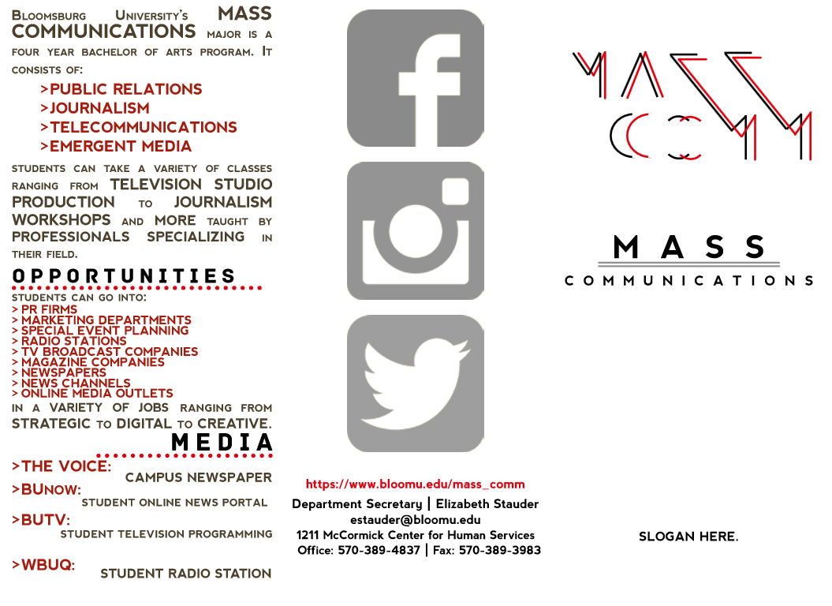
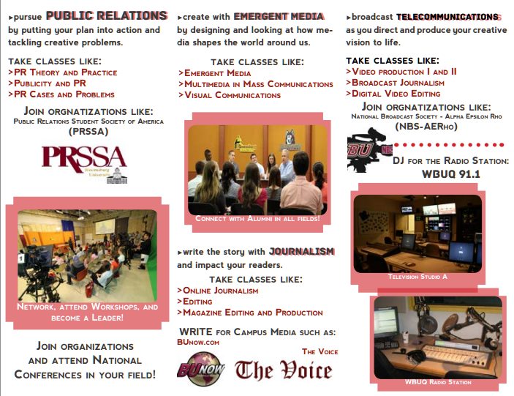
Visual materials
mass
communications
mass
communications
DREAM. CREATE. ACHIEVE.
9

Slide 10
Promotional Video
A video will go here.
10

Slide 11
Social Media and Media Relations
Departmental Social Media Accounts:
Facebook
Twitter
Instagram
Partner with Student Media and Organizations for events.
Work with the College of Liberal Arts and the University to participate in events.
Open Houses and Tours
Major and Minors Fair
11

